Slide 1
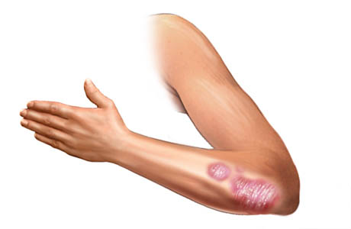
A Computational Biology Framework

Slide 2
Introduction
Feature selection
Lookback
Results
Conclusions
TPOT
Layout improvements
Quality enhancement
Feature distributions
Classification results
Framework
Update
General comments
Graduation presentation
A Computational Biology Framework

Slide 3
Feature selection
Lookback and TPOT implementation

Slide 4
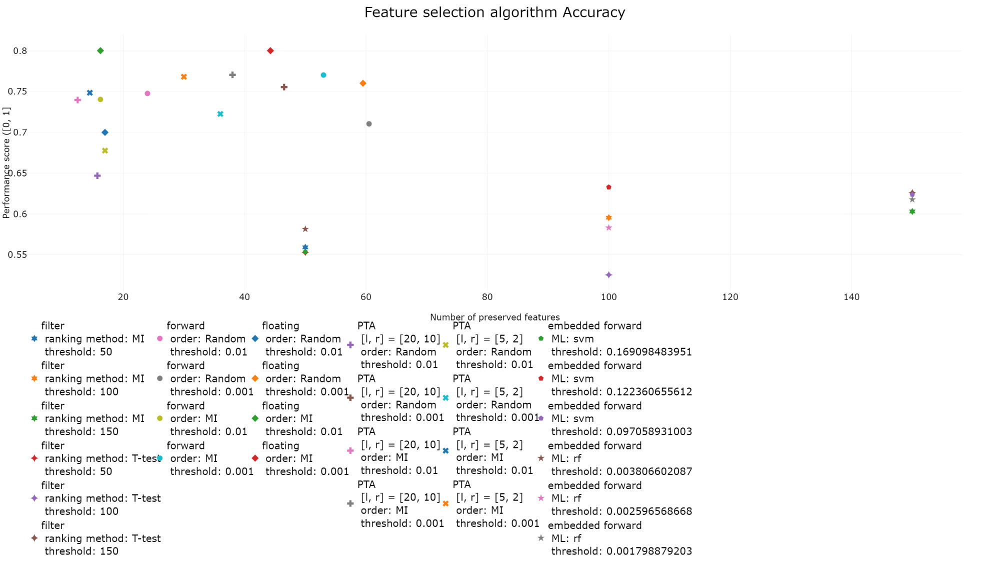
Feature selection
A Computational Biology Framework

Slide 5
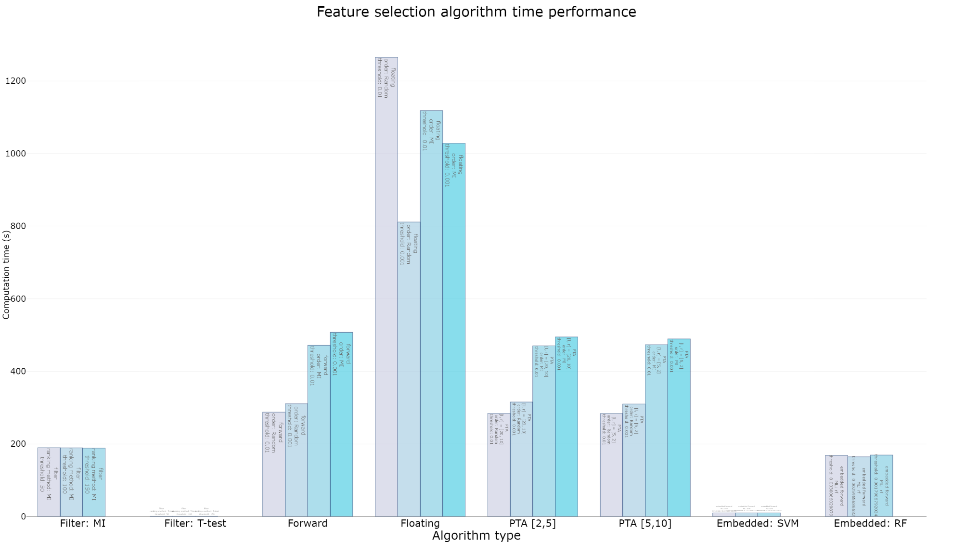
Feature selection
A Computational Biology Framework

Slide 6
TPOT
Added feature selection possibility
Always starting with feature selection
New accuracy function:
Accuracy = Accuracy(Pipeline) – Features * Threshold
Tested algorithms present:
Filter and Embedded methods
High feature selection possibility:
Preservation < 200 features
Wrapper methods included
A Computational Biology Framework

Slide 7
Missing values
Quality Enhancement
Missing values
Outlier detection
Missing values
Missing Completely At Random (MCAR)
Missing At Random (MAR)
Missing Not At Random (MNAR)
A Computational Biology Framework

Slide 8
Missing values
List Deletion
Complete Case Analysis
Available Case Analysis
Weighted Case analysis
Single Imputation
Missing indicator imputation
Mean/Median/Mode imputation
Hot deck imputation
Regression imputation
Nearest Neighbor imputation
Multiple Imputation
Multiple Imputation Chained Equations (MICE)
A Computational Biology Framework

Slide 9
Missing values
Datasets
Four Datasets:
Heart Attacks, Hepatitis, Cirrhosis and Cervical Cancer
Between 1% and 15% of entries being missing values
Missing values algorithms
All implemented and ready for testing
Testing
Value distributions (same after handling?)
Change in mean/mode and variance
Classification/Regression improvement
What way of handling missing values works best for results?
A Computational Biology Framework

Slide 10
General information
Planning
Next meeting week of August 13th with Peter and Joaquin preferred
Finishing missing values
Start outlier handling
Master project
View supervisor on project
Finish October
Deadline from Data Science
Joint presentation
A Computational Biology Framework

